Slide 1
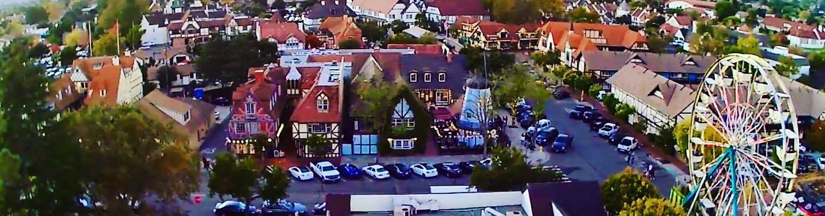
Information on Solvang’s Municipal Election & Measure E-2024

Slide 2
What is Measure E-2024?
On June 10th, the Solvang City Council placed Measure E-2024 – The Solvang Tourism Enhancement and Mitigation Measure -- on the November Municipal ballot for voter consideration.
Measure E-2024 is a proposed 2% increase to the local hotel/lodging tax that is paid by visitors and tourists who stay in the local hotels and lodging in Solvang.

Slide 3
Official Measure E-2024 Ballot Question
Solvang Tourism Enhancement and Mitigation Measure.
To continue funding for Solvang tourism related services, such as: pothole, street/ sidewalk repair; traffic safety, parking relief; senior, adult/ youth recreation programs; 911 response; and general government use, shall the City adopt a measure increasing Solvang’s existing transient occupancy (hotel) tax charged to hotel guests only, by 2% until ended by voters, providing an additional $1,000,000 annually, that cannot be taken by Sacramento, with citizens' oversight, independent audits?
YES NO

Slide 4
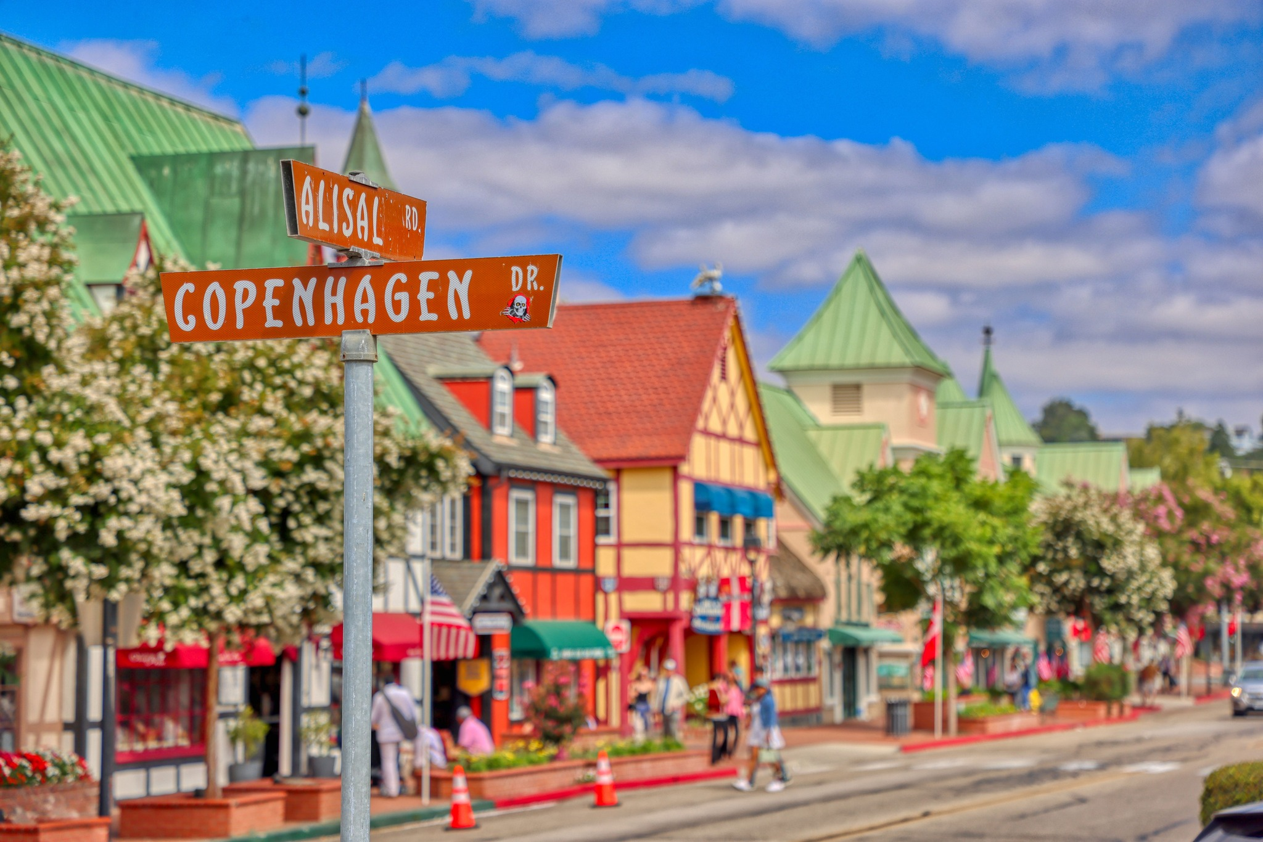
Identified Priorities – 2024 Community Survey
Measure E-2024 funding could address resident identified City service funding priorities such as maintaining pothole and street repair, completing deferred maintenance of streets, roads, sidewalks, and City facilities, maintaining City parks, providing traffic safety and parking relief, maintaining senior, adult and youth recreation programs and City funded community and special events and maintaining 911 emergency response.

Slide 5
If enacted, Measure E-2024 is Locally Controlled Funding
If enacted, Measure E-2024 funding will provide a source of local funding ONLY for Solvang to maintain core services and priorities identified by the public.
No funds can be taken by the County.
No funds can be taken by the State.
Measure E-2024 is not a tax on Solvang residents (that are not staying in Solvang hotels/lodging) or their property.

Slide 6

Measure E-2024 Accountability & Transparency Provisions
Measure E-2024 includes accountability requirements:
  Independent oversight with public disclosure of all spending
  Annual independent financial audits
  Performance reports
  All of which will be available online
Measure E-2024 is not a tax on Solvang residents that are not staying in Solvang hotels/lodging
Measure E-2024 allows visitors to contribute to the cost of services they utilize so that residents do not need to shoulder the cost.

Slide 7

What Else is on the November 5th Municipal Ballot?
Solvang voters will also have the opportunity to decide on the City’s next Mayor and Councilmembers for Districts 1 and 2.

Slide 8
November 5th Voting Information

Slide 9

November 5th Voting Information
Vote by mail ballots will be mailed the week of October 7^{th.}
Your ballot must be postmarked on or before Election Day and received by the Elections Division by no later than three days after Election Day.
You can drop your ballot to any drop box in the County by 8pm on Election Day.
Track your ballot: California.ballottrax.net
Not registered to vote?
Register online at: registertovote.ca.gov

Slide 10
For More Information on Solvang’s Municipal Election
For more information on Solvang’s Municipal Election or Measure E-2024, visit:
www.CityofSolvang.com/MeasureE-2024
For more information on the Vote by Mail election and voting procedures, visit:
www.countyofsb.org/Elections

Slide 11
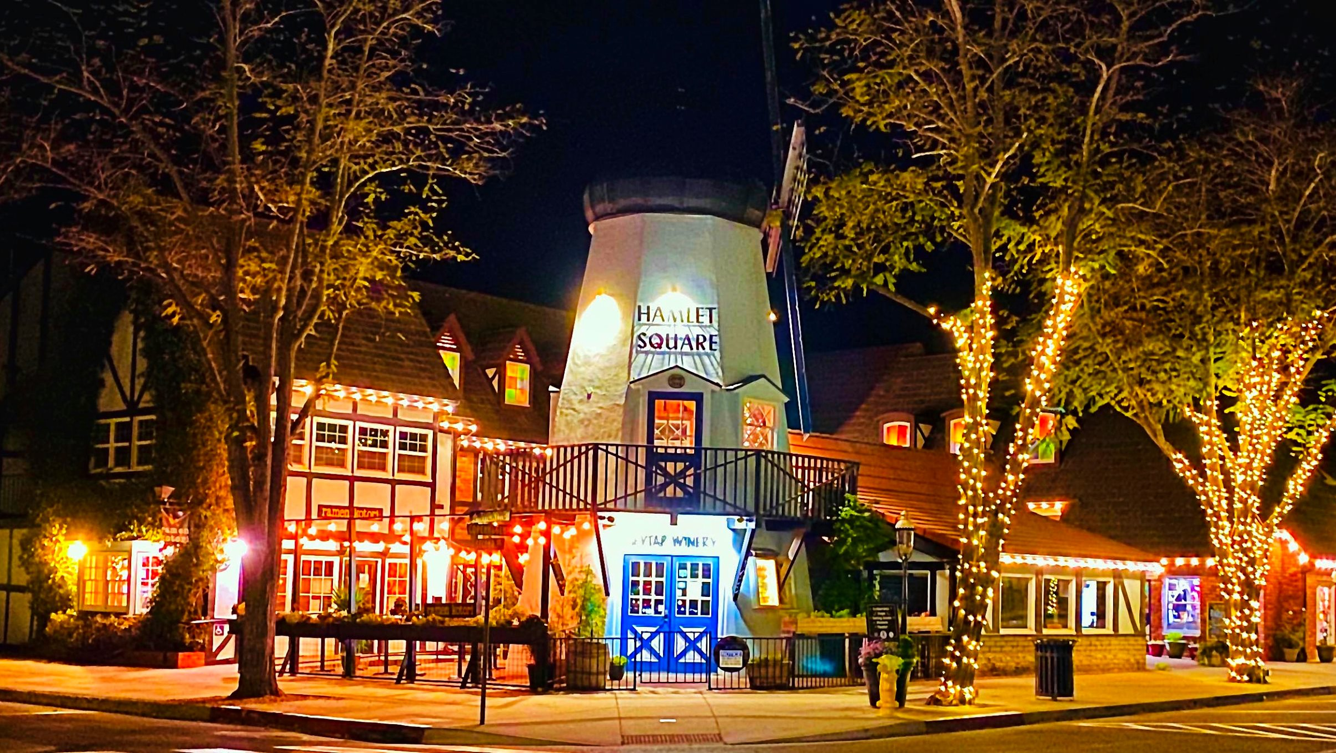
Questions?

